Slide 1
JAVA
DEPARTMENT OF CSE

Slide 2
UNIT – 2
CLASSES
DEPARTMENT OF CSE

Slide 3
Class Fundamentals
It defines a new data type
Once defined, this new type can be used to create objects of that type
A class is a template for an object, and an object is an instance of a class
DEPARTMENT OF CSE

Slide 4
The General Form of a Class
  class classname {
  type instance-variable1;
  type instance-variable2;
  // ...
  type instance-variableN;
  type methodname1(parameter-list) {
  // body of method
  }
  type methodname2(parameter-list) {
  // body of method
  }
  // ...
  type methodnameN(parameter-list) {
  // body of method
  }
  }
DEPARTMENT OF CSE

Slide 5
Collectively, the methods and variables defined within a class are called members of the class
Variables defined within a class are called instance variables because each instance
of the class contains its own copy of these variables
DEPARTMENT OF CSE

Slide 6
A Simple Class
class Box {
double width;
double height;
double depth;
}
Box mybox = new Box();
// create a Box object called mybox
DEPARTMENT OF CSE

Slide 7
To access these variables, you will use the dot (.) operator
The dot operator links the name of the object with the name of an instance variable
Example:
mybox.width = 100;
DEPARTMENT OF CSE

Slide 8
class Box {
double width;
double height;
double depth;
}
// This class declares an object of type Box.
class BoxDemo {
public static void main(String args[]) {
Box mybox = new Box();
double vol;
// assign values to mybox's instance variables
mybox.width = 10;
mybox.height = 20;
mybox.depth = 15;
// compute volume of box
vol = mybox.width * mybox.height * mybox.depth;
System.out.println("Volume is " + vol);
}
}
DEPARTMENT OF CSE

Slide 9
When you compile this program, you will find that two .class files have been created, one for Box and one for BoxDemo
The Java compiler automatically puts each class into its own .class file
DEPARTMENT OF CSE

Slide 10
  class Box {
  double width;
  double height;
  double depth;
  }
  class BoxDemo2 {
  public static void main(String args[]) {
  Box mybox1 = new Box();
  Box mybox2 = new Box();
  double vol;
  // assign values to mybox1's instance variables
  mybox1.width = 10;
  mybox1.height = 20;
  mybox1.depth = 15;
  /* assign different values to mybox2's instance variables */
  mybox2.width = 3;
  mybox2.height = 6;
  mybox2.depth = 9;
  // compute volume of first box
  vol = mybox1.width * mybox1.height * mybox1.depth;
  System.out.println("Volume is " + vol);
  // compute volume of second box
  vol = mybox2.width * mybox2.height * mybox2.depth;
  System.out.println("Volume is " + vol);
  }
  }
DEPARTMENT OF CSE

Slide 11
Declaring Objects
First, you must declare a variable of the class type
This variable does not define an object ; Instead, it is simply a variable that can refer to an object
Second, you must acquire an actual, physical copy of the object and assign it to that variable. You can do this using the new operator
DEPARTMENT OF CSE

Slide 12
The new operator dynamically allocates memory for an object and returns a reference to it
Box mybox; // declare reference to object
mybox = new Box(); // allocate a Box object
OR
Box mybox = new Box();
DEPARTMENT OF CSE

Slide 13
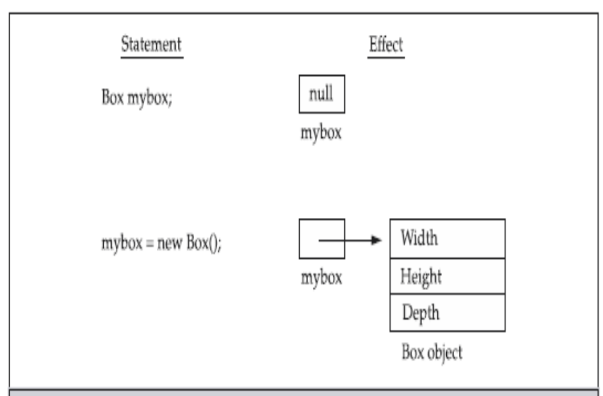
DEPARTMENT OF CSE

Slide 14
Assigning Object Reference Variables
Example:
  Box b1 = new Box();
  Box b2 = b1;
b1 and b2 will both refer to the same object
The assignment of b1 to b2 did not allocate any memory or copy any part of the original object
Any changes made to the object through b2 will affect the object to which b1 is referring, since they are the same object
DEPARTMENT OF CSE

Slide 15
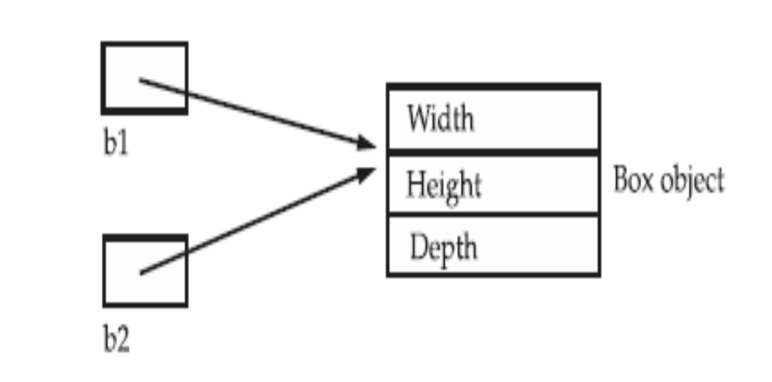
DEPARTMENT OF CSE

Slide 16
Although b1 and b2 both refer to the same object, they are not linked in any other way
Example:
  Box b1 = new Box();
  Box b2 = b1;
  // ...
  b1 = null;
Here, b1 has been set to null, but b2 still points to the original object
DEPARTMENT OF CSE

Slide 17
Note:
When you assign one object reference variable to another object reference variable, you are not creating a copy of the object, you are only making a copy of the reference
DEPARTMENT OF CSE

Slide 18
Introducing Methods
type name(parameter-list) {
// body of method
}
type specifies the type of data returned by the method
If the method does not return a value, its return type must be void
The parameter-list is a sequence of type and identifier pairs separated by commas
DEPARTMENT OF CSE

Slide 19
Return
return value;
DEPARTMENT OF CSE

Slide 20
class Box {
double width;
double height;
double depth;
// display volume of a box
void volume() {
System.out.print("Volume is ");
System.out.println(width * height * depth);
}
}
class BoxDemo3 {
public static void main(String args[]) {
Box mybox1 = new Box();
Box mybox2 = new Box();
// assign values to mybox1's instance variables
mybox1.width = 10;
mybox1.height = 20;
mybox1.depth = 15;
/* assign different values to mybox2's
instance variables */
mybox2.width = 3;
mybox2.height = 6;
mybox2.depth = 9;
// display volume of first box
mybox1.volume();
// display volume of second box
mybox2.volume();
}
}
DEPARTMENT OF CSE

Slide 21
class Box {
double width;
double height;
double depth;
// compute and return volume
double volume() {
return width * height * depth;
}
}
class BoxDemo4 {
public static void main(String args[]) {
Box mybox1 = new Box();
Box mybox2 = new Box();
double vol;
// assign values to mybox1's instance variables
mybox1.width = 10;
mybox1.height = 20;
mybox1.depth = 15;
/* assign different values to mybox2's instance variables */
mybox2.width = 3;
mybox2.height = 6;
mybox2.depth = 9;
// get volume of first box
vol = mybox1.volume();
System.out.println("Volume is " + vol);
// get volume of second box
vol = mybox2.volume();
System.out.println("Volume is " + vol);
}
}
DEPARTMENT OF CSE

Slide 22
class Box {
double width;
double height;
double depth;
// compute and return volume
double volume() {
return width * height * depth;
}
// sets dimensions of box
void setDim(double w, double h, double d) {
width = w;
height = h;
depth = d;
}
}
class BoxDemo5 {
public static void main(String args[]) {
Box mybox1 = new Box();
Box mybox2 = new Box();
double vol;
// initialize each box
mybox1.setDim(10, 20, 15);
mybox2.setDim(3, 6, 9);
// get volume of first box
vol = mybox1.volume();
System.out.println("Volume is " + vol);
// get volume of second box
vol = mybox2.volume();
System.out.println("Volume is " + vol);
}
}
DEPARTMENT OF CSE

Slide 23
Constructors
A constructor initializes an object immediately upon creation
It has the same name as the class in which it resides and is syntactically similar to a method
Have no return type, not even void
DEPARTMENT OF CSE

Slide 24
class Box {
double width;
double height;
double depth;
// This is the constructor for Box.
Box() {
System.out.println("Constructing Box");
width = 10;
height = 10;
depth = 10;
}
// compute and return volume
double volume() {
return width * height * depth;
}
}
class BoxDemo6 {
public static void main(String args[]) {
// declare, allocate, and initialize Box objects
Box mybox1 = new Box();
Box mybox2 = new Box();
double vol;
// get volume of first box
vol = mybox1.volume();
System.out.println("Volume is " + vol);
// get volume of second box
vol = mybox2.volume();
System.out.println("Volume is " + vol);
}
}
DEPARTMENT OF CSE

Slide 25
Consider
Box mybox1 = new Box();
new Box( ) is calling the Box( ) constructor
When you do not explicitly define a constructor for a class, then Java creates a default constructor for the class
The default constructor automatically initializes all instance variables to zero
DEPARTMENT OF CSE

Slide 26
Parameterized Constructors
class Box {
double width;
double height;
double depth;
// This is the constructor for Box.
Box(double w, double h, double d) {
width = w;
height = h;
depth = d;
}
// compute and return volume
double volume() {
return width * height * depth;
}
}
DEPARTMENT OF CSE

Slide 27
class BoxDemo7 {
public static void main(String args[]) {
// declare, allocate, and initialize Box objects
Box mybox1 = new Box(10, 20, 15);
Box mybox2 = new Box(3, 6, 9);
double vol;
// get volume of first box
vol = mybox1.volume();
System.out.println("Volume is " + vol);
// get volume of second box
vol = mybox2.volume();
System.out.println("Volume is " + vol);
}
}
DEPARTMENT OF CSE

Slide 28
The this Keyword
this can be used inside any method to refer to the current object
this is always a reference to the object on which the method was invoked
Example:
Box(double w, double h, double d) {
this.width = w;
this.height = h;
this.depth = d;
}
DEPARTMENT OF CSE

Slide 29
// Use this to resolve name-space collisions.
Box(double width, double height, double depth) {
this.width = width;
this.height = height;
this.depth = depth;
}
DEPARTMENT OF CSE

Slide 30
Garbage Collection
In some languages, such as C++, dynamically allocated objects must be manually released by use of a delete operator
Java takes a different approach; it handles deallocation for you automatically
The technique that accomplishes this is called garbage collection
DEPARTMENT OF CSE

Slide 31
Contd..
When no references to an object exist, that object is assumed to be no longer needed, and the memory occupied by the object can be reclaimed
There is no explicit need to destroy objects as in C++
DEPARTMENT OF CSE

Slide 32
The finalize( ) Method
Sometimes an object will need to perform some action when it is destroyed
For example, if an object is holding some non-Java resource such as a file handle or window character font, then you might want to make sure these resources are freed before an object is destroyed
DEPARTMENT OF CSE

Slide 33
By using finalization, you can define specific actions that will occur when an object is just about to be reclaimed by the garbage collector
To add a finalizer to a class, you simply define the finalize( ) method
Inside the finalize( ) method you will specify those actions that must be performed before an object is destroyed
DEPARTMENT OF CSE

Slide 34
The finalize( ) method has this general form:
protected void finalize( )
{
// finalization code here
}
The keyword protected is a specifier that prevents access to finalize( ) by code defined outside its class
DEPARTMENT OF CSE

Slide 35
It is important to understand that finalize( ) is only called just prior to garbage collection
It is not called when an object goes out-of-scope, for example
This means that you cannot know when—or even if—finalize( ) will be executed
Therefore, your program should provide other means of releasing system resources, etc., used by the object
DEPARTMENT OF CSE

Slide 36
Example: A Stack Class
class Stack {
int stck[] = new int[10];
int tos;
// Initialize top-of-stack
Stack() {
tos = -1;
}
// Push an item onto the stack
void push(int item) {
if(tos==9)
System.out.println("Stack is full.");
else
stck[++tos] = item;
}
// Pop an item from the stack
int pop() {
if(tos < 0) {
System.out.println("Stack underflow.");
return 0;
}
else
return stck[tos--];
}
}
DEPARTMENT OF CSE

Slide 37
class TestStack {
public static void main(String args[]) {
Stack mystack1 = new Stack();
Stack mystack2 = new Stack();
// push some numbers onto the stack
for(int i=0; i<10; i++) mystack1.push(i);
for(int i=10; i<20; i++) mystack2.push(i);
// pop those numbers off the stack
System.out.println("Stack in mystack1:");
for(int i=0; i<10; i++)
System.out.println(mystack1.pop());
System.out.println("Stack in mystack2:");
for(int i=0; i<10; i++)
System.out.println(mystack2.pop());
}
}
DEPARTMENT OF CSE

Slide 38
Overloading Methods
In Java it is possible to define two or more methods within the same class that share the same name, as long as their parameter declarations are different
When an overloaded method is invoked, Java uses the type and/or number of arguments as its guide to determine which version of the overloaded method to actually call
The return type alone is insufficient to distinguish two versions of a method
DEPARTMENT OF CSE

Slide 39
class OverloadDemo {
void test() {
System.out.println("No parameters");
}
// Overload test for one integer parameter.
void test(int a) {
System.out.println("a: " + a);
}
// Overload test for two integer parameters.
void test(int a, int b) {
System.out.println("a and b: " + a + " " + b);
}
// overload test for a double parameter
double test(double a) {
System.out.println("double a: " + a);
return a*a;
}
}
DEPARTMENT OF CSE

Slide 40
class Overload {
public static void main(String args[]) {
OverloadDemo ob = new OverloadDemo();
double result;
// call all versions of test()
ob.test();
ob.test(10);
ob.test(10, 20);
result = ob.test(123.25);
System.out.println("Result of ob.test(123.25): " + result);
}
}
DEPARTMENT OF CSE

Slide 41
In some cases Java’s automatic type conversions can play a role in overload resolution
Java will employ its automatic type conversions only if no exact match is found
DEPARTMENT OF CSE

Slide 42
// Automatic type conversions apply to overloading.
class OverloadDemo {
void test() {
System.out.println("No parameters");
}
// Overload test for two integer parameters.
void test(int a, int b) {
System.out.println("a and b: " + a + " " + b);
}
// overload test for a double parameter
void test(double a) {
System.out.println("Inside test(double) a: " + a);
}
}
DEPARTMENT OF CSE

Slide 43
class Overload {
public static void main(String args[]) {
OverloadDemo ob = new OverloadDemo();
int i = 88;
ob.test();
ob.test(10, 20);
ob.test(i); // this will invoke test(double)
ob.test(123.2); // this will invoke test(double)
}
}
DEPARTMENT OF CSE

Slide 44
This program generates the following output:
    No parameters
    a and b: 10 20
    Inside test(double) a: 88
    Inside test(double) a: 123.2
DEPARTMENT OF CSE

Slide 45
Overloading Constructors
class Box {
double width;
double height;
double depth;
// constructor used when all dimensions specified
Box(double w, double h, double d) {
width = w;
height = h;
depth = d;
}
DEPARTMENT OF CSE

Slide 46
// constructor used when no dimensions specified
Box() {
width = -1; // use -1 to indicate
height = -1; // an uninitialized
depth = -1; // box
}
// constructor used when cube is created
Box(double len) {
width = height = depth = len;
}
// compute and return volume
double volume() {
return width * height * depth;
}
}
DEPARTMENT OF CSE

Slide 47
class OverloadCons {
public static void main(String args[]) {
// create boxes using the various constructors
Box mybox1 = new Box(10, 20, 15);
Box mybox2 = new Box();
Box mycube = new Box(7);
double vol;
// get volume of first box
vol = mybox1.volume();
System.out.println("Volume of mybox1 is " + vol);
// get volume of second box
vol = mybox2.volume();
System.out.println("Volume of mybox2 is " + vol);
// get volume of cube
vol = mycube.volume();
System.out.println("Volume of mycube is " + vol);
}
}
DEPARTMENT OF CSE

Slide 48
Using Objects as Parameters
// Objects may be passed to methods.
class Test {
int a, b;
Test(int i, int j) {
a = i;
b = j;
}
// return true if o is equal to the invoking object
boolean equals(Test o) {
if(o.a == a && o.b == b) return true;
else return false;
}
}
DEPARTMENT OF CSE

Slide 49
class PassOb {
public static void main(String args[]) {
Test ob1 = new Test(100, 22);
Test ob2 = new Test(100, 22);
Test ob3 = new Test(-1, -1);
System.out.println("ob1 == ob2: " + ob1.equals(ob2));
System.out.println("ob1 == ob3: " + ob1.equals(ob3));
}
}
DEPARTMENT OF CSE

Slide 50
Contd..
There are two ways that a computer language can pass an argument to a subroutine
Call by value
Call by reference
DEPARTMENT OF CSE

Slide 51
Contd..
when you pass a simple type to a method, it is passed by value
// Simple types are passed by value.
class Test {
void meth(int i, int j) {
i *= 2;
j /= 2;
}
}
DEPARTMENT OF CSE

Slide 52
Contd..
class CallByValue {
public static void main(String args[]) {
Test ob = new Test();
int a = 15, b = 20;
System.out.println("a and b before call: " + a + " " + b);
ob.meth(a, b);
System.out.println("a and b after call: " + a + " " + b);
}
}
The output from this program is shown here:
a and b before call: 15 20
a and b after call: 15 20
DEPARTMENT OF CSE

Slide 53
Contd..
Objects are passed by reference
Changes to the object inside the method do affect the object used as an argument
// Objects are passed by reference.
class Test {
int a, b;
Test(int i, int j) {
a = i;
b = j;
}
DEPARTMENT OF CSE

Slide 54
// pass an object
void meth(Test o) {
o.a *= 2;
o.b /= 2;
}
}
class CallByRef {
public static void main(String args[]) {
Test ob = new Test(15, 20);
System.out.println("ob.a and ob.b before call: " +
ob.a + " " + ob.b);
ob.meth(ob);
System.out.println("ob.a and ob.b after call: " +
ob.a + " " + ob.b);
}
}
This program generates the following output:
ob.a and ob.b before call: 15 20
ob.a and ob.b after call: 30 10
DEPARTMENT OF CSE

Slide 55
Returning Objects
A method can return any type of data, including class types that you create
// Returning an object.
class Test {
int a;
Test(int i) {
a = i;
}
Test incrByTen() {
Test temp = new Test(a+10);
return temp;
}
}
DEPARTMENT OF CSE

Slide 56
class RetOb {
public static void main(String args[]) {
Test ob1 = new Test(2);
Test ob2;
ob2 = ob1.incrByTen();
System.out.println("ob1.a: " + ob1.a);
System.out.println("ob2.a: " + ob2.a);
ob2 = ob2.incrByTen();
System.out.println("ob2.a after second increase: “ + ob2.a);
}
}
The output generated by this program is shown here:
ob1.a: 2
ob2.a: 12
ob2.a after second increase: 22
DEPARTMENT OF CSE

Slide 57
Recursion
Java supports recursion
Recursion is the process of defining something in terms of itself
As it relates to Java programming, recursion is the attribute that allows a method to call itself
A method that calls itself is said to be recursive
DEPARTMENT OF CSE

Slide 58
// A simple example of recursion.
class Factorial {
// this is a recursive function
int fact(int n) {
int result;
if(n==1) return 1;
result = fact(n-1) * n;
return result;
}
}
class Recursion {
public static void main(String args[]) {
Factorial f = new Factorial();
System.out.println("Factorial of 3 is " + f.fact(3));
System.out.println("Factorial of 4 is " + f.fact(4));
System.out.println("Factorial of 5 is " + f.fact(5));
}
}
DEPARTMENT OF CSE

Slide 59
Recursive versions of many routines may execute a bit more slowly than the iterative equivalent because of the added overhead of the additional function calls
Because storage for parameters and local variables is on the stack and each new call creates a new copy of these variables, it is possible that the stack could be exhausted
If this occurs, the Java run-time system will cause an exception
DEPARTMENT OF CSE

Slide 60
The main advantage to recursive methods is that they can be used to create clearer and simpler versions of several algorithms than can their iterative relatives
DEPARTMENT OF CSE

Slide 61
// Another example that uses recursion.
class RecTest {
int values[];
RecTest(int i) {
values = new int[i];
}
// display array -- recursively
void printArray(int i) {
if(i==0) return;
else printArray(i-1);
System.out.println("[" + (i-1) + "] " + values[i-1]);
}
}
class Recursion2 {
public static void main(String args[]) {
RecTest ob = new RecTest(10);
int i;
for(i=0; i<10; i++) ob.values[i] = i;
ob.printArray(10);
}
}
DEPARTMENT OF CSE

Slide 62
This program generates the following output:
[0] 0
[1] 1
[2] 2
[3] 3
[4] 4
[5] 5
[6] 6
[7] 7
[8] 8
[9] 9
DEPARTMENT OF CSE

Slide 63
Introducing Access Control
Java’s access specifiers are public, private, and protected
protected applies only when inheritance is involved
When a member of a class is modified by the public specifier, then that member can be accessed by any other code
When a member of a class is specified as private, then that member can only be accessed by other members of its class
DEPARTMENT OF CSE

Slide 64
/* This program demonstrates the difference between public and private. */
class Test {
int a; // default access
public int b; // public access
private int c; // private access
// methods to access c
void setc(int i) { // set c's value
c = i;
}
int getc() { // get c's value
return c;
}
}
DEPARTMENT OF CSE

Slide 65
class AccessTest {
public static void main(String args[]) {
Test ob = new Test();
// These are OK, a and b may be accessed directly
ob.a = 10;
ob.b = 20;
// This is not OK and will cause an error
// ob.c = 100; // Error!
// You must access c through its methods
ob.setc(100); // OK
System.out.println("a, b, and c: " + ob.a + " " +
ob.b + " " + ob.getc());
}
}
DEPARTMENT OF CSE

Slide 66
Understanding static
When a member is declared static, it can be accessed before any objects of its class are created, and without reference to any object
The most common example of a static member is main( )
main( ) is declared as static because it must be called before any objects exist
Instance variables declared as static are, essentially, global variables
DEPARTMENT OF CSE

Slide 67
Methods declared as static have several restrictions:
They can only call other static methods
They must only access static data
They cannot refer to this or super in any way
DEPARTMENT OF CSE

Slide 68
We can declare a static block which gets executed exactly once, when the class is first loaded
DEPARTMENT OF CSE

Slide 69
// Demonstrate static variables, methods, and blocks.
class UseStatic {
static int a = 3;
static int b;
static void meth(int x) {
System.out.println("x = " + x);
System.out.println("a = " + a);
System.out.println("b = " + b);
}
static {
System.out.println("Static block initialized.");
b = a * 4;
}
public static void main(String args[]) {
meth(42);
}
}
DEPARTMENT OF CSE

Slide 70
As soon as the UseStatic class is loaded, all of the static statements are run
First, a is set to 3, then the static block executes (printing a message), and finally, b is initialized to a * 4 or 12
Then main( ) is called, which calls meth( ), passing 42 to x
DEPARTMENT OF CSE

Slide 71
If you wish to call a static method from outside its class, you can do so using the following general form:
classname.method( )
Here, classname is the name of the class in which the static method is declared
DEPARTMENT OF CSE

Slide 72
class StaticDemo {
static int a = 42;
static int b = 99;
static void callme() {
System.out.println("a = " + a);
}
}
class StaticByName {
public static void main(String args[]) {
StaticDemo.callme();
System.out.println("b = " + StaticDemo.b);
}
}
Here is the output of this program:
a = 42
b = 99
DEPARTMENT OF CSE

Slide 73
Introducing final
A variable can be declared as final
Doing so prevents its contents from being modified
We must initialize a final variable when it is declared
final int FILE_NEW = 1;
final int FILE_OPEN = 2;
DEPARTMENT OF CSE

Slide 74
Variables declared as final do not occupy memory on a per-instance basis
The keyword final can also be applied to methods, but its meaning is substantially different than when it is applied to variables
DEPARTMENT OF CSE

Slide 75
Arrays Revisited
Implemented as objects
The size of an array—that is, the number of elements that an array can hold—is found in its length instance variable
// This program demonstrates the length array member.
class Length {
public static void main(String args[]) {
int a1[] = new int[10];
int a2[] = {3, 5, 7, 1, 8, 99, 44, -10};
int a3[] = {4, 3, 2, 1};
System.out.println("length of a1 is " + a1.length);
System.out.println("length of a2 is " + a2.length);
System.out.println("length of a3 is " + a3.length);
} }
DEPARTMENT OF CSE

Slide 76
Introducing Nested and Inner Classes
It is possible to define a class within another class
The scope of a nested class is bounded by the scope of its enclosing class
If class B is defined within class A, then B is known to A, but not outside of A
A nested class has access to the members, including private members, of the class in which it is nested
DEPARTMENT OF CSE

Slide 77
However, the enclosing class does not have access to the members of the nested class
There are two types of nested classes: static and non-static
A static nested class is one which has the static modifier applied
DEPARTMENT OF CSE

Slide 78
The most important type of nested class is the inner class
An inner class is a non-static nested class
It has access to all of the variables and methods of its outer class
DEPARTMENT OF CSE

Slide 79
// Demonstrate an inner class.
class Outer {
int outer_x = 100;
void test() {
Inner inner = new Inner();
inner.display();
}
// this is an inner class
class Inner {
void display() {
System.out.println("display: outer_x = " + outer_x);
}
}
}
class InnerClassDemo {
public static void main(String args[]) {
Outer outer = new Outer();
outer.test();
}
}
DEPARTMENT OF CSE

Slide 80
It is important to realize that class Inner is known only within the scope of class Outer
The Java compiler generates an error message if any code outside of class Outer attempts to instantiate class Inner
DEPARTMENT OF CSE

Slide 81
// This program will not compile.
class Outer {
int outer_x = 100;
void test() {
Inner inner = new Inner();
inner.display();
}
// this is an inner class
class Inner {
int y = 10; // y is local to Inner
void display() {
System.out.println("display: outer_x = " + outer_x);
}
}
void showy() {
System.out.println(y); // error, y not known here!
}
}
class InnerClassDemo {
public static void main(String args[]) {
Outer outer = new Outer();
outer.test();
}
}
DEPARTMENT OF CSE

Slide 82
While nested classes are not used in most day-to-day programming, they are particularly helpful when handling events in an applet
DEPARTMENT OF CSE

Slide 83
Using Command-Line Arguments
// Display all command-line arguments.
class CommandLine {
public static void main(String args[]) {
for(int i=0; i<args.length; i++)
System.out.println("args[" + i + "]: " +
args[i]);
}
}
Execution:
java CommandLine this is a test 100 -1
When you do, you will see the following output:
args[0]: this
args[1]: is
args[2]: a
args[3]: test
args[4]: 100
args[5]: -1
DEPARTMENT OF CSE

